Slide 1





Slide 2

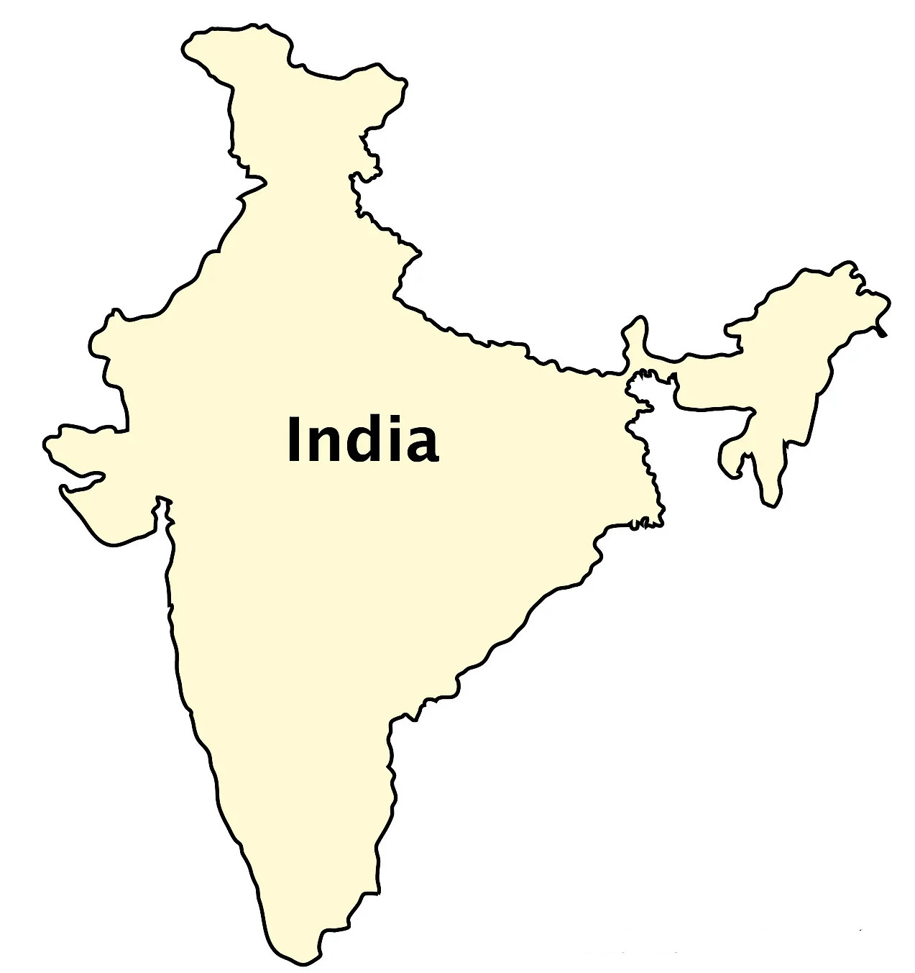

Slide 3
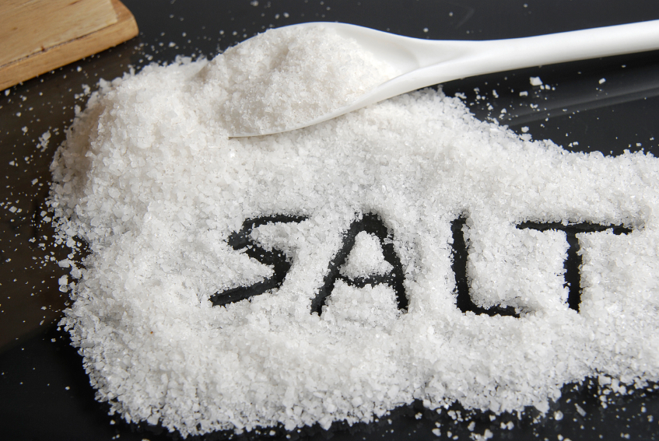
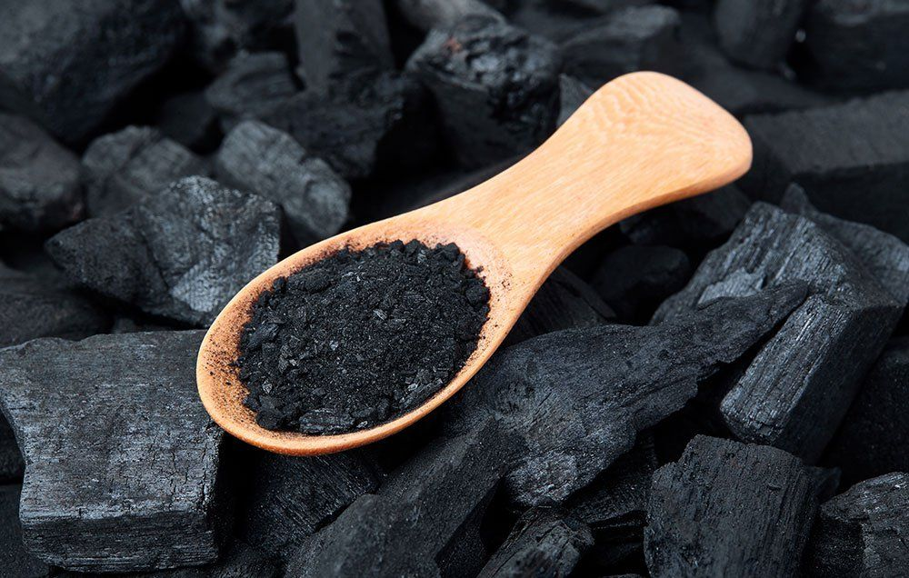

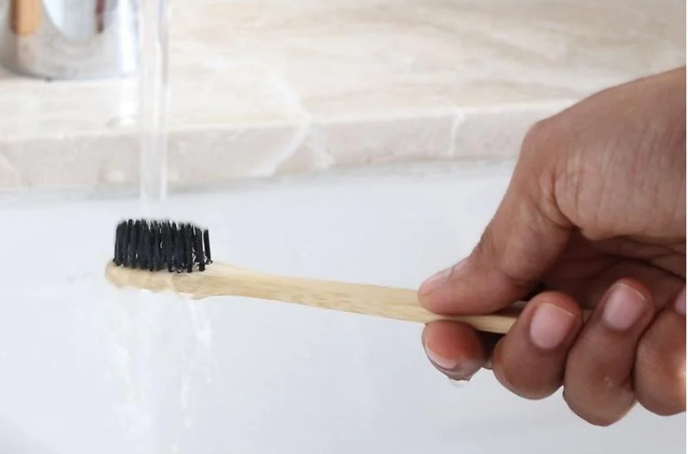

Slide 4
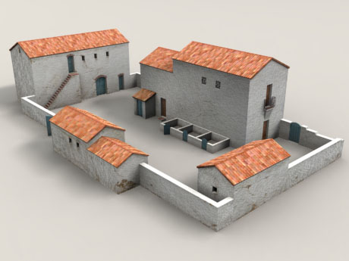


Slide 5



Slide 6


Ocean of Wisdom

Slide 7
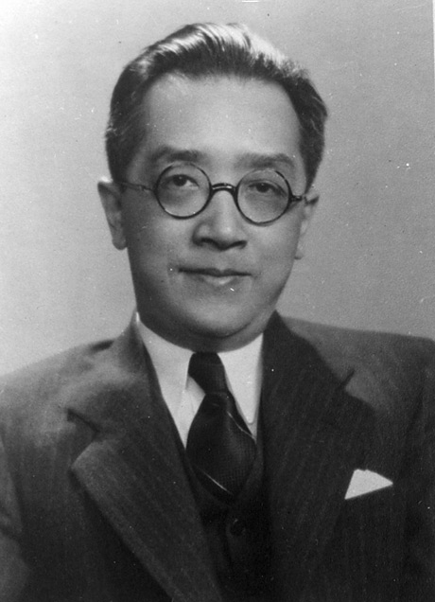
Influence of Vedic Culture
“India conquered and dominated China culturally for 20 centuries without ever having to send a single soldier across her border.”
Hu Shih, former Ambassador of China to USA
http://qna.rediff.com/questions-and-answers/hu-shih-former-ambassador-of-china-to-usa-said/18671365/answers

Slide 8
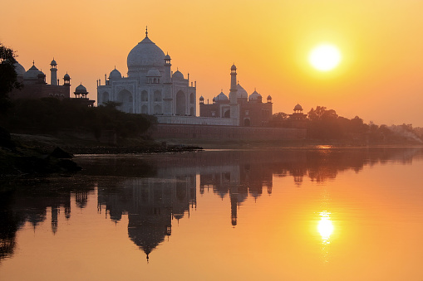
We are the sunrise people,
Good morning is our song!

Slide 9
8 Branches of Ayurveda – Ashtang Ayurveda
Sr. No. | Types of Chikitsa | Treatment
1 | Kayachikitsa | General Medicine
2 | Shalakyatantra | Opthalmology
3 | Shalyatantra | Surgery
4 | Agada Tantra | Toxicology
5 | Bhutvidya | Psychiatrics
6 | Vajeekaran | Diseases of genital organs
7 | Kumaryabhyatrya tantra | Pediatrics
8 | Rasayana Chikitsa | Geriatrics (Science of Anti-aging)

Slide 10
Rasayan Properties
Antioxidant
Nutritive
Adaptogenic
Immunomodulatory
Anti-Aging
R
A
S
A
Y
A
N
A
C
T
I
O
N
Nourishes and maintains the cell life (Neutraceutical action).
Encourages the growth of new cells (Regenerative action).
Prevents recurrent infection, expelling the damaged cells (Immunomodulatory action).
Eliminates the toxic metabolites and pollutants (Antioxidant action).
Maintains the balance between mind and body (Adaptogenic).
Rasayan acts at the sub-cellular level.

Slide 11
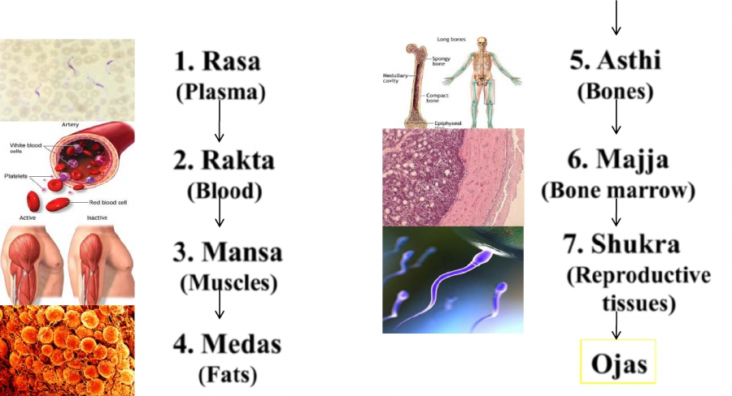
Body nourishment

Slide 12
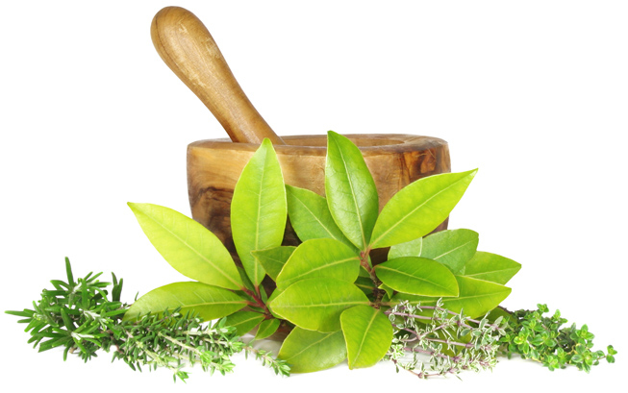
“Even the incurable diseases respond well through rasayan chikitsa.” Dhalana
R a s a y a n
Adaptogen
Imuno-modulator
Anti-aging
Anti-oxidant
Nutritive

Slide 13



Health connects us all

Slide 14
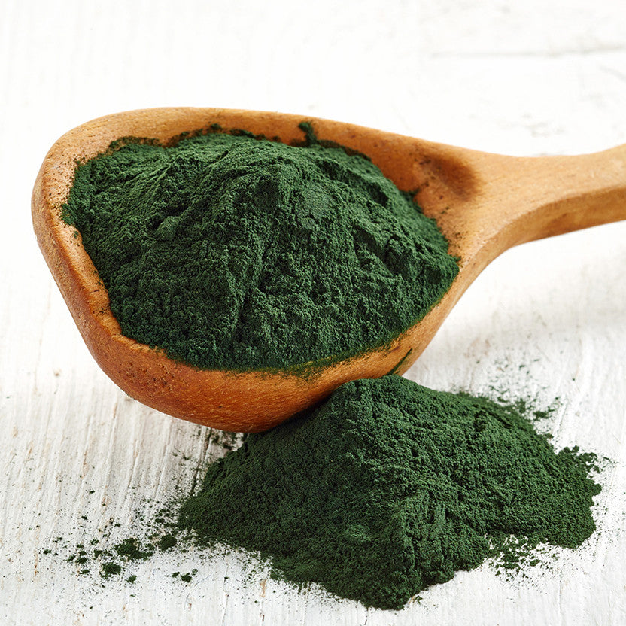
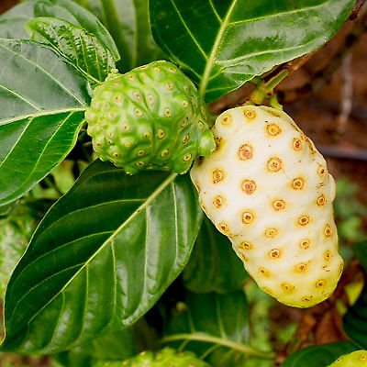
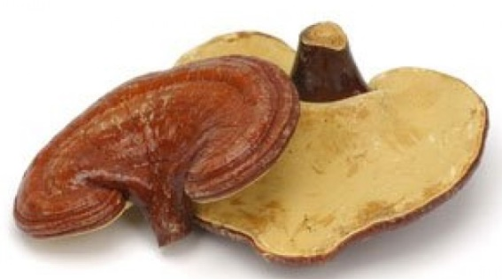
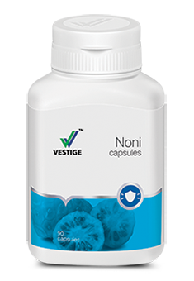
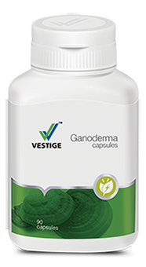
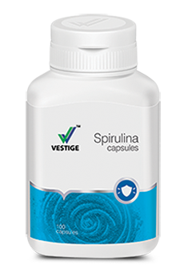

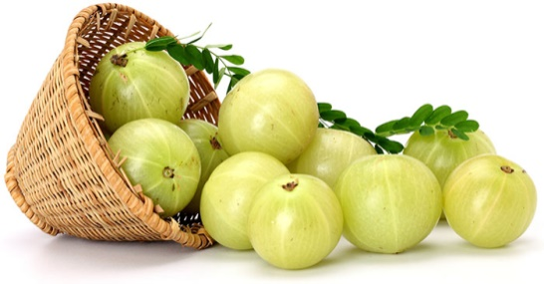
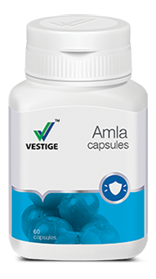

RASAYAN - Science of Anti-Aging

Slide 15

365 days Anti-Aging
Program
Mon | Tue | Wed | Thu | Fri | Sat | Sun

Slide 16


Slide 17

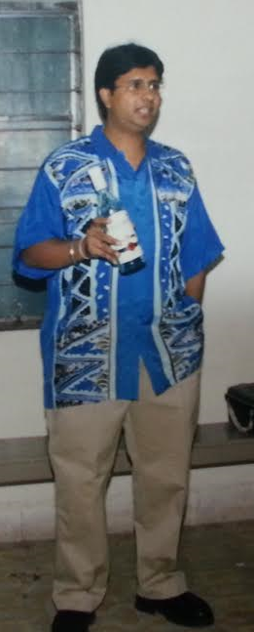


R a s a y a n e f f e c t…

Slide 18


R a s a y a n e f f e c t…

Slide 19



Slide 20
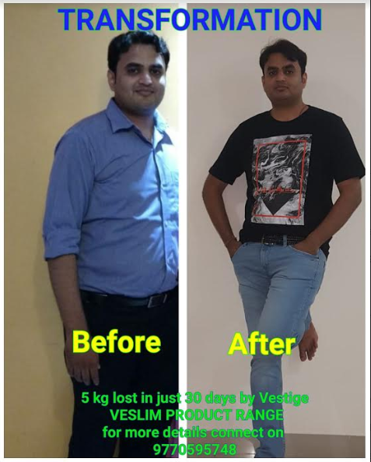

Slide 22
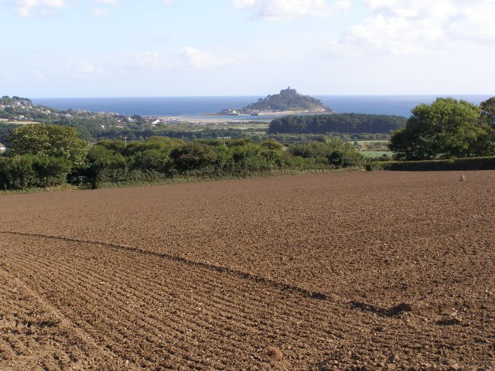
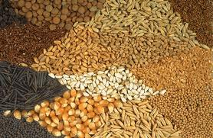
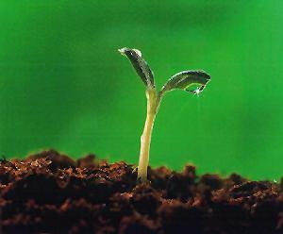
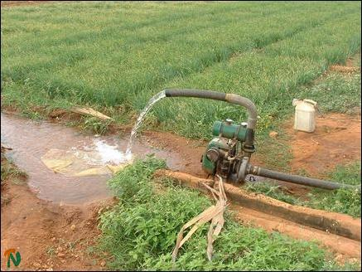
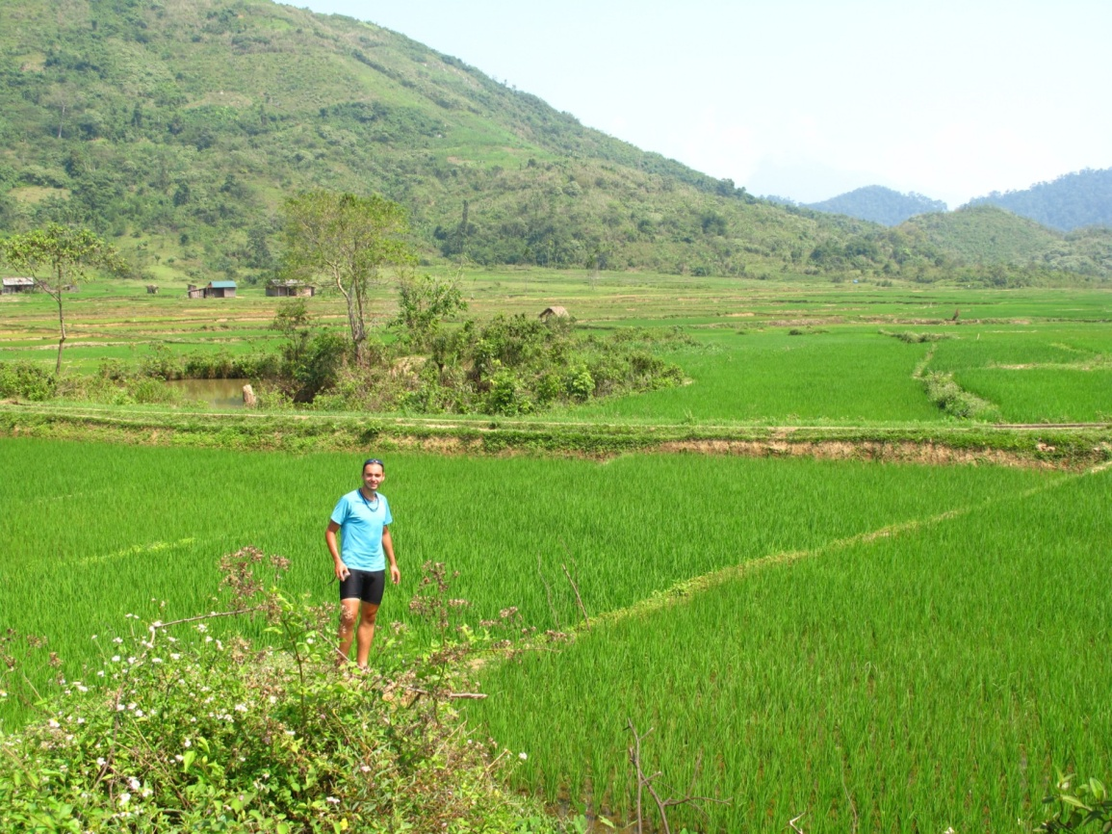
Land
Seed
Water
Climate

Slide 23
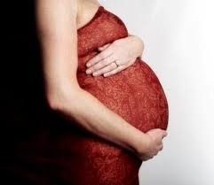
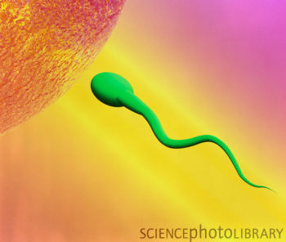

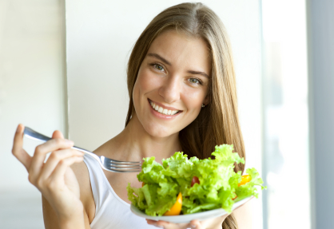
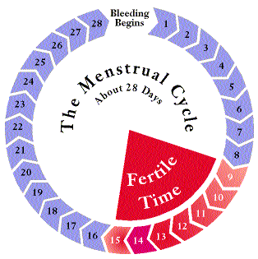

Slide 24
Science of Anti-Aging!
Mon | Tue | Wed | Thu | Fri | Sat | Sun

Slide 25

We are the sunrise people,
Good morning is our song!

